Slide 1

Workshop on Pharmaceutical Engineering for Undergraduate Engineering Education
Stephanie Farrell, Zenaida Otero Gephardt,
Mariano J. Savelski, C. Stewart Slater,
Department of Chemical Engineering
Rowan University
Glassboro, New Jersey
Session 1a
2012 ASEE Summer School for ChE Faculty
Orono, ME July 21-26, 2012

Slide 2
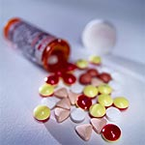
Workshop Goals
Present essential elements of pharmaceutical engineering relevant to a ChE
Describe methods of curricular enhancement through:
  Homework problems/illustrative examples
  Demonstrations
  Laboratory experiments
  Course integration into introductory ChE courses
Additional learning resources through compendium of educational materials and pharmaceutical education site: www.PharmaHUB.org

Slide 3
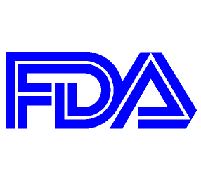

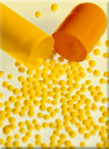
Workshop Agenda
Introduction
Primer on Pharmaceutical Engineering
Drug Manufacture (Mixing operations)
Drug Delivery
Problem Sets in Pharma Eng
Pharma Life Cycle Analysis tutorial
PharmaHUB tutorial

Slide 4
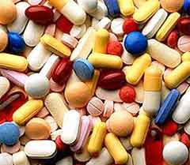
Background
Most Introductory ChE educational materials focus on traditional aspects of chemical processing
New technology can be adapted and introduced when basic concepts are taught within the context of existing courses
Need to prepare students for graduate education/research: medicine, bio-eng, pharma engineering and careers in the field

Slide 5






NSF ERC-SOPS
Rowan is an Outreach Partner institution of the ERC – Structured Organic Particulate Systems (Rutgers lead institution)
The Center’s research focus is on pharmaceutical processing which include: manufacturing science; composites structuring and characterization; and particle formation and functionalization

Slide 6
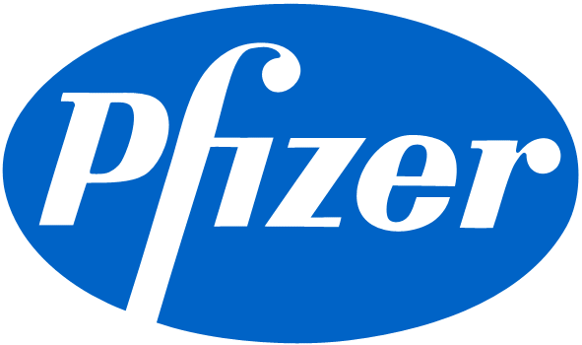









Primer on Pharmaceutical Industry
Major commercial sector in U.S. and worldwide
Major employer in MidAtlantic region
Prepare ChEs for roles in:
  R&D
  Process Design/Engineering
  Manufacturing
  Environmental/Health/Safety
  Sustainability
  Regulatory Affairs
  Marketing and Sales

Slide 7

The pharmaceutical industry’s main goal is to discover, develop and deliver innovative medicines that help patients prevail over serious diseases*
API (Active Pharmaceutical Ingredient)
  The compound within the pill or solution that treats the disease
$331.3 billion in U.S. pharmaceutical sales - 2011**
Highly regulated by Federal government (FDA, DEA)
* Bristol-Myers Squibb Mission Statement (www.bms.com) 2012
** Business Monitor International. United States Pharmaceuticals and Healthcare Report Q2 2012. March 2012.

Slide 8
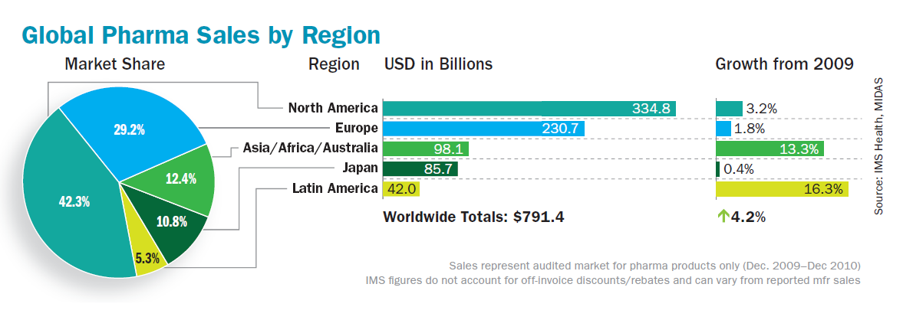
Worldwide Pharmaceutical Industry
2010
Five of the top-ten companies are based in the United States:
#1 Pfizer, #4 Merck, #8 Johnson & Johnson, #9 Eli Lilly, #10 Abbot
Image from: J. Cacciotti and P. Clinton. “The Lull Between Two Storms.” Pharmaceutical Executive. 2010.

Slide 9
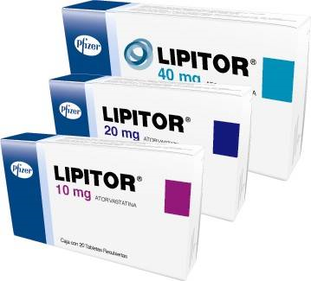
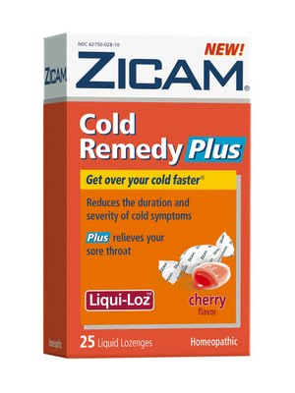
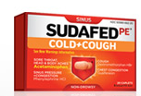
Top selling prescription drug (2011) was Lipitor® (Pfizer) with global sales of $10.7 billion
  But this goes off-patent in 2012 and will be manufactured generically
Generic market is expanding worldwide
Top selling over the counter (OTC) drug category (2010) is “cough/cold related” drugs with U.S. sales of $4.05 billion
K. Stone. “Top Branded Drug Sales for 2011.” http://pharma.about.com/od/Sales_and_Marketing/tp/Top-Branded-Drug-Sales-For-2011.htm. Viewed June 2012
“OTC Sales by Category -- 2007-2010.” Consumer Healthcare Products Association. http://www.chpa-info.org/pressroom/Sales_Category.aspx. Viewed 2012.

Slide 10
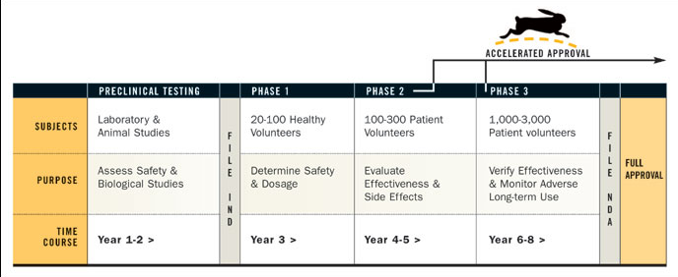
Drug Development Timeline
7-11 years between development and manufacture – Regulatory steps (Phase I-III)
10% success rate for new drug development
Once process is approved by FDA, any changes are hard to implement
ChEs involved in R&D/scale-up/manufacture

Slide 11
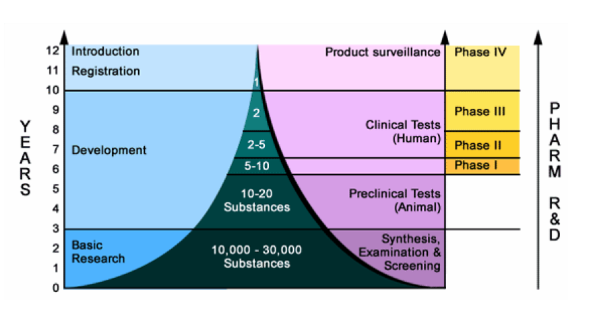
Drug Development Attrition Rate
Takes >$800 Mil to develop a new drug
Glasser and Pedersen, Pharmaceutical Bulk Drug Production, ERC Educational Modules, www.pharmaHUB.org/resources/286, 2009
Original source: Merck

Slide 12
Pharmaceutical Manufacture
Energy
Energy
Raw materials: Reactants, etc.
Excipients
API
API Manufacture
Drug Formulation
Drug Delivery
Solvents
Waste
Waste
“Bulk” Pharmaceutical Production Steps –
Reaction and Purification Processes
Drug Manufacture Processes to Formulate API into Dosage
Drug Delivery into Body

Slide 13
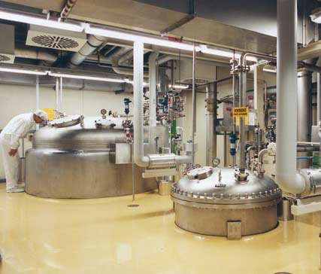
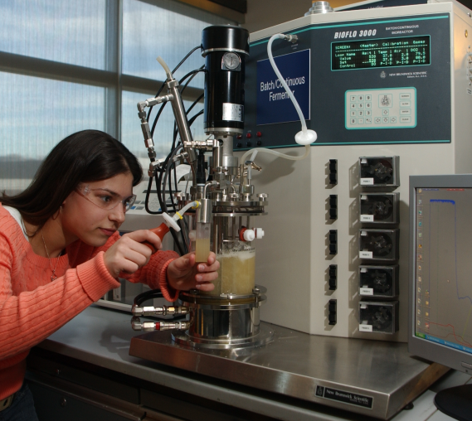
API Manufacture
Natural product isolation
Biotechnology / biochemical synthesis (“large” molecule API)
Organic synthesis (“small” molecule API)
Terminology
Transformation = Reaction step
Isolation = Separation or Purification step

Slide 14
API Manufacture
Drugs manufactured in a batch process
Typical range of amounts produced depends on the drug potency and sales projections
Widely prescribed drugs >100’s MT/yr*
The batch processing steps will be repeated over and over again (“campaigns”) to produce the amount of API needed for annual drug production
*1 metric ton (MT) = 1,000 kg

Slide 15
Typical Drug Synthesis – “Campaigns”
Multi-step synthesis, transformations – Intermediate compounds
Isolations (purification)
S-1
S-2
R-5
S-15
S-16
S-17
R-1
I-1
I-1
I-1
I-5
I-5
I-5
I-5
API
S = Solvent – vary in number and complexity for each step
R = Reactant – vary in number and complexity for each step
I = Intermediate
API = Active Pharmaceutical Ingredient
Slater, Savelski, Carole, Constable, Green Chemistry in the Pharmaceutical Industry, Wiley-VCH, Germany, 49-82, 2010

Slide 16
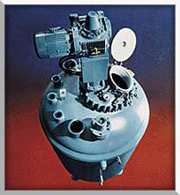
Manufacturing Issues
Storage
Batch-based processes
Extensive use of multiple organic solvents and reagents – varying degrees of toxicity
Waste generated and emission over life cycle
Crystallization
Distillation
Mixing
Top Ten Solvents
Methanol n-Butyl alcohol
Dichloromethane N-methyl-2-pyrrolidone
Toluene N,N-Dimethylformamide
Acetonitrile Ammonia
Chlorobenzene Formic acid
Filtration
Reaction
Extraction
Slater, Savelski, Carole, Constable, Green Chemistry in the Pharmaceutical Industry, Wiley-VCH, Germany, 49-82, 2010
2008 TRI Releases for the Pharma sector

Slide 17
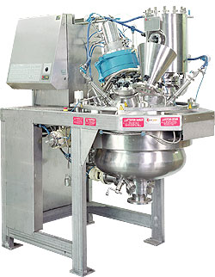
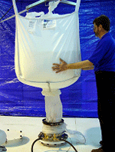

Manufacturing Issues
Solid/Liquid processing – centrifugation, filtration, drying
  Wastes generated
  Fugitive emissions
  Solids handling
  Dust explosion potential
Purity vs. yield
Outsourcing process steps
Specialty Chem. Co. B
Drug Manufacturer
Slater, Savelski, Carole, Constable, Green Chemistry in the Pharmaceutical Industry, Wiley-VCH, Germany, 49-82, 2010
Fine Chem. Co. A

Slide 18
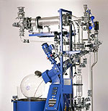
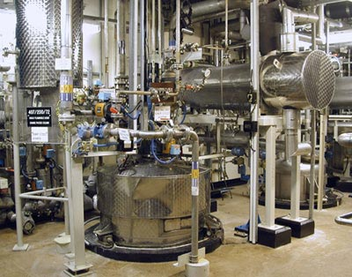
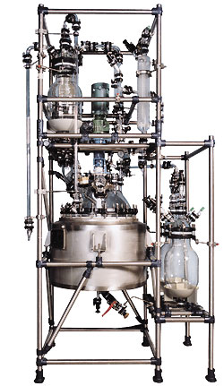
Magnitude of Scale
Discovery
Manufacturing
Lab Scale
~10 g API
~100 mL vessel
Manufacturing Scale
>1000 kg API
(1 metric ton)
>10,000 L vessel
Clinical Trials
Pilot Plant Scale
~20 - 200 kg API
~200 - 2000 L vessel

Slide 19
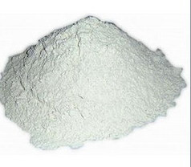
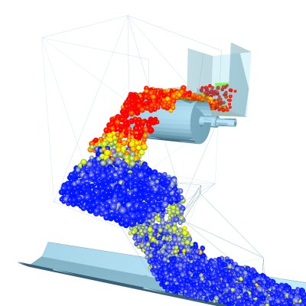
Drug Formulation Processes
Batch processes are typically used
  Blending/mixing, milling/grinding, drying, etc
API is blended with various “excipients”
  Fillers, binders, lubricants, flavors, colors, . . .
Unlike API synthesis, drug formulation usually involves solid phase components
  Solid phase mixtures – tablets & capsules
Particle size and particle interaction are important factors
Robson, Scientific Computing World, 2007

Slide 20
Raw materials
Drug Formulation
Excipients
Oven
drying
Milling
Crystallization
Filtration /
drying
Blending
Lubrication
Granulation
Compression
Coating
Finished products
Adapted from: Glasser and Pedersen, Pharmaceutical Bulk Drug Production, ERC Educational Modules, www.pharmaHUB.org/resources/286, 2009

Slide 21
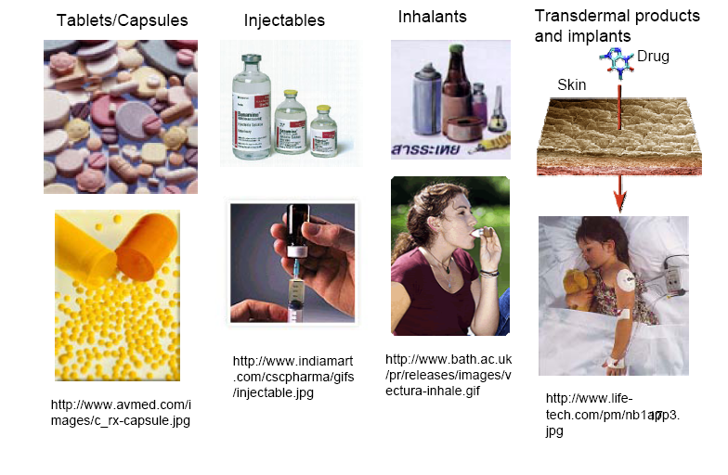
Drug Delivery Methods
Glasser and Pedersen, Pharmaceutical Bulk Drug Production, ERC Educational Modules, www.pharmaHUB.org/resources/286, 2009

Slide 22
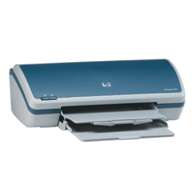
ERC-SOPS Novel Dosage Formation
Research underway at NSF-ERC (www.ercforsops.org) at Rutgers University
Pharmaceutical plant of the future could be a personalized compact device, such as a modified ink-jet printer
Formulary of multiple drugs in cassette form
  Greatly reduced facilities cost
  Reduced batch size
  Reduce wasted product
  Personalized dosage based on weight
  On-site use for military, emergency response, developing countries
Muzzio, ERC-SOPS Annual Meeting, Rutgers University, Piscataway, NJ, Dec 2006

Slide 23
Acknowledgements
NSF ERC for Structured Organic Particulate Systems: grant # 0540855
Rutgers University
  Henrik Pederson, Center Director – Education
  Aisha Lawrey, Center Associate Director – Education, Outreach and Diversity
U.S. Environmental Protection Agency: grant #NP97212311-0

